Slide 1
GHOST KITCHEN
QUICKBITE
Performance FINDINGS
BY: CECILIA WANJIRU

Slide 2
Ghost Kitchen Performance Overview
Location | Order Volume | Revenue | Fixed cost | Profit | Profit Margin | Growth Rate
Kilimani | 8,088 | KES 6.37M | KES 2.44M | KES 1.39M | 21.9% | -1.2%
Westlands | 6,638 | KES 4.75 M | KES 2.73 M | KES 179K | 3.8% | -7.2%
Eastleigh | 6,637 | KES 3.64M | KES 1.88M | KES 403K | 11.1% | 33.6%
Kilimani
Westlands
Eastleigh
CFOs’decision of reallocating resources to killimani is not bad because the data proves that it generate the highest profit and margins(growth and profit ).
It has the slowest delivery time of 69 minutes a gap of 27minutes between its competitors.
It costs more to run Westlands than Kilimani yet it makes less revenue. It has the lowest profit of KES 179K and lowest profit margin of 3.8%.
It is situated in an area that has the highest number of competitors which might be contributing to its decline
This is the only location with consistent growth across every metric every single month.
It contributings to 20% of the profit, which is double than what Westlands (9%) is generating

Slide 3
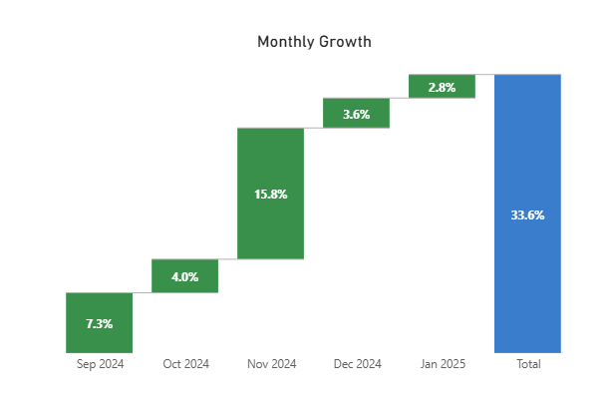
Eastleighs’ Story
Eastleigh monthly growth rate for the past 6 months
CFO
The CFO is looking at the revenue and order volume only But the margins state otherwise. A profit margin of 11.1%, and the only location with consistent growth.
Profit: which shows for a fact it is not bleeding money Eastleigh: 403K Westlands: 179K
Eastleigh makes more than double what Westlands is generating. Which is where we should focus on right now.
GM
The GM did have some insight of what was going on in Eastleigh . It does happen to be the only location that has a good customer rating of 4.1 which is higher than its competitor's rating 3.8 .
Customers order Pilau, Samosa and Mandazi most frequently. This explains why Eastleigh might seem to be bleeding money. Customers order the cheap items from the menu.
The highest REVENUE comes from combos meals like Chicken Biriyani + Pilau .
Recommendation: Do not shut down Eastleigh. We should give Eastleigh 3 Months to see the change. Based on the current growth rate 33.6%, it is possible to achieve targets of the numbers we set for monthly orders then, we can reassess the data then

Slide 4
Should QuickBite Expand Ghost Kitchen?
Currently the overall profit margin is 13.4%. It might not be enough for a new location.
We need to focus on increasing revenue and profit in Westlands, that might look like Cutting down it’s the fixed cost, or it might look like relocating to a new location
Westlands might be next issue to solve instead of expanding
Priority for the next location
This only applies if there is relocation or Expanding
Low Fixed cost. Based on the findings we would want to avoid mistakes where like westlands we pay more than what we get
Low Competition. Eastleigh a month the 3 locations has the least competition but with the right market
Recommendation: Do not Expand right now Instead, Solve Westlands Urgent Issue the high fixed cost and decrease in margins which might result to Relocating Westlands or end up expanding. Hold on Expanding Ghost Kitchen.

Slide 5
Menu Optimizations
Location | Most ordered Items | Top Revenue Items | Average Delivery Time | AoV
Kilimani | Nyama Choma, Chicken Biriyani, Pilau | Nyama Choma | Chicken Biriyani| Pilau | 69 minutes | KES 788
Westlands | Samosa(6), Chicken Biriyani | Nyama Choma|Chicken Biryani|Samosa | 64 minutes | KES 716
Eastleigh | Pilau, Samosa, Mandazi | Chicken Biriyani | Pilau | 56 minutes | KES 549
1. Introduce combo meals. Eastleigh customers seem to order a lot of items that are cheap on the menu. This results to least increase in The revenue compared to Kilimani Eastleigh has a high customer rating so the customers love them, so they should take advantage that Test combo meals, especially during the weekends and peak hours (8pm-9pm) Combo meals like Pilau + Chicken Biriyani since they both contribute as top revenue generators when combined. This would Increase the AoV from KES 549.
2. Fix Delivery Time. The Delivery time problem seems to be affecting all three locations. Which affects each locations rating . By Hiring more drivers this could lead to Fast Delivery which may improve customer ratings and increase in Order volume hence more revenue.
3. Customize the menu based on the market. Customers in Eastleigh have a lower order volume In items like Nyama Choma Platter. Concentrate on what they already like (Pilau and Biriyani) but also test out new dishes. Eastleigh is a Swahili/Somali cultured place. Test new dishes like Shawarmas. This will increase Revenue and Total Orders

